Slide 1



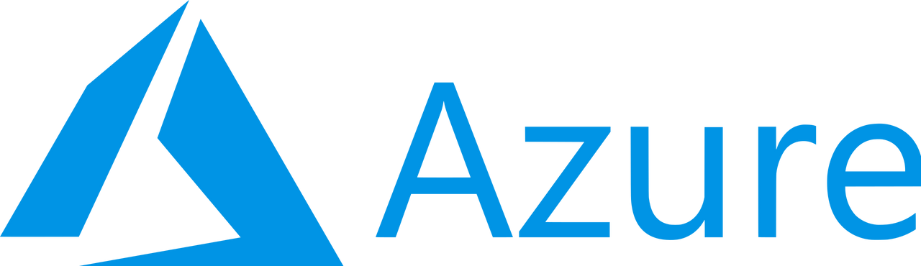
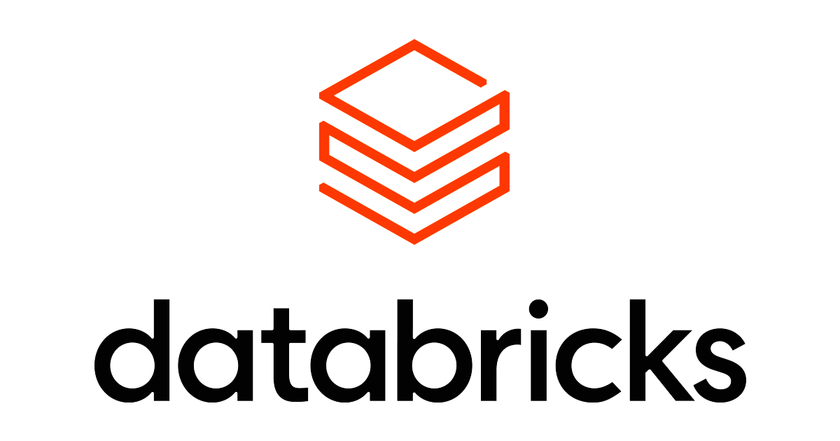







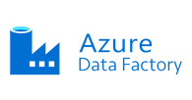




What is Delta Lake?
Azure Data Engineering
Dr Sachin Saxena
Follow on

Slide 2

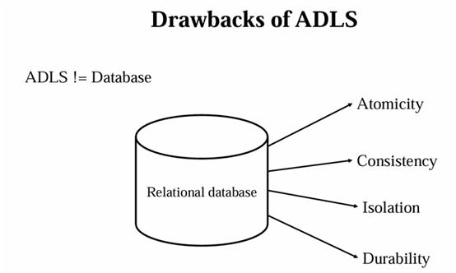

What is Delta Lake?
Delta is a key feature in Azure Databricks designed for managing data lakes effectively.
It brings ACID transactions to Apache Spark and big data workloads, ensuring data consistency, reliability, and enabling version control.
Dr Sachin Saxena
Follow on

Slide 3

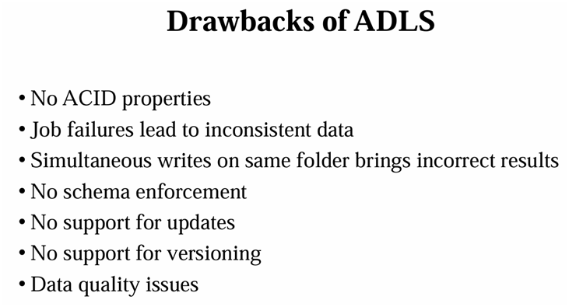
Dr Sachin Saxena
Follow on
We'll explore how Delta Lake revolutionizes data storage and management, ensuring ACID transactions and seamless schema evolution within a unified framework.

Slide 4

Delta Lake:
One of the foundational technologies provided by the Databricks Lakehouse Platform is an open-source, file-based storage format that brings reliability to data lakes.
Delta Lake is an open source technology that extends Parquet data files with a file-based transaction log for ACID transactions that brings reliability to data lakes.
ADLS != Database, in RDBMS there is called ACID Properties which is not available in ADLS.
Dr Sachin Saxena
Follow on

Slide 5

What is Delta Lake?
It is an Open-source framework that brings reliability to data lakes.
Brings transaction capabilities to data lakes.
Runs on top of your existing data lake and supports parquet.
Delta Lake is not a data warehouse or a database.
Enables Lakehouse architecture
Dr Sachin Saxena
Follow on

Slide 6
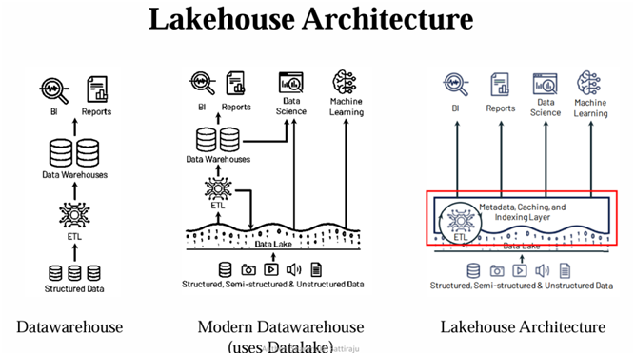
Dr Sachin Saxena
Datawarehouse can work only on structure data, which is first generation evolution.
However it is supporting ACID properties. One can delete, update and perform data governance on it.
Datawarehouse cannot handle the data other than structure cannot serve a ML use cases.
Databricks gave a paper on Lakehouse, which proposed the solution by just having a single system that manages both the things.
Follow on

Slide 7

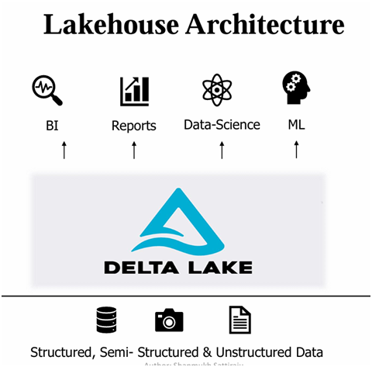
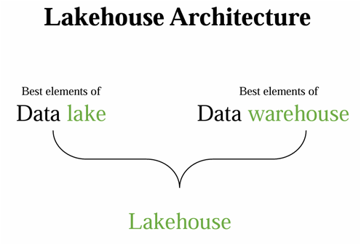
Dr Sachin Saxena
Follow on
Data Lake itself will be having an additional metadata layer for data management, which having a transaction logs that gives the capability of data warehouse.
Now Data Lake House is built by best features of both. Now we can see there are some best elements of Data Lake and there are best elements of Data Warehouse. Lake House also provides traditional analytical DBMs management and performance features such as Acid transaction versioning, auditing, indexing, caching, and query optimization.

Slide 8
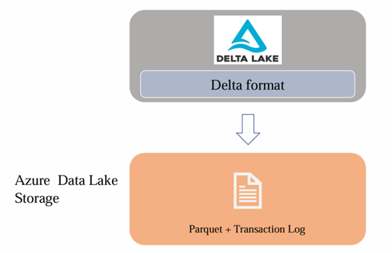
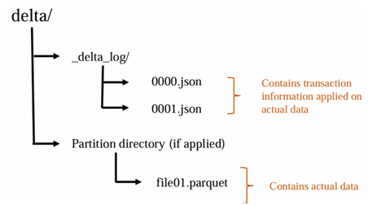
Dr Sachin Saxena
Follow on
Using data lake we are unable to perform Update operation. Only in delta lake this operation is supportive.
Even using spark.sql, are unable to perform Update operation. This is one of Drawbacks of ADLS.
Versioning is also not available in ADLS, which is Drawbacks of ADLS.
Transaction logs tracks changes to delta table and it is responsible for bringing the ACID compliance for Delta lake.

Slide 9
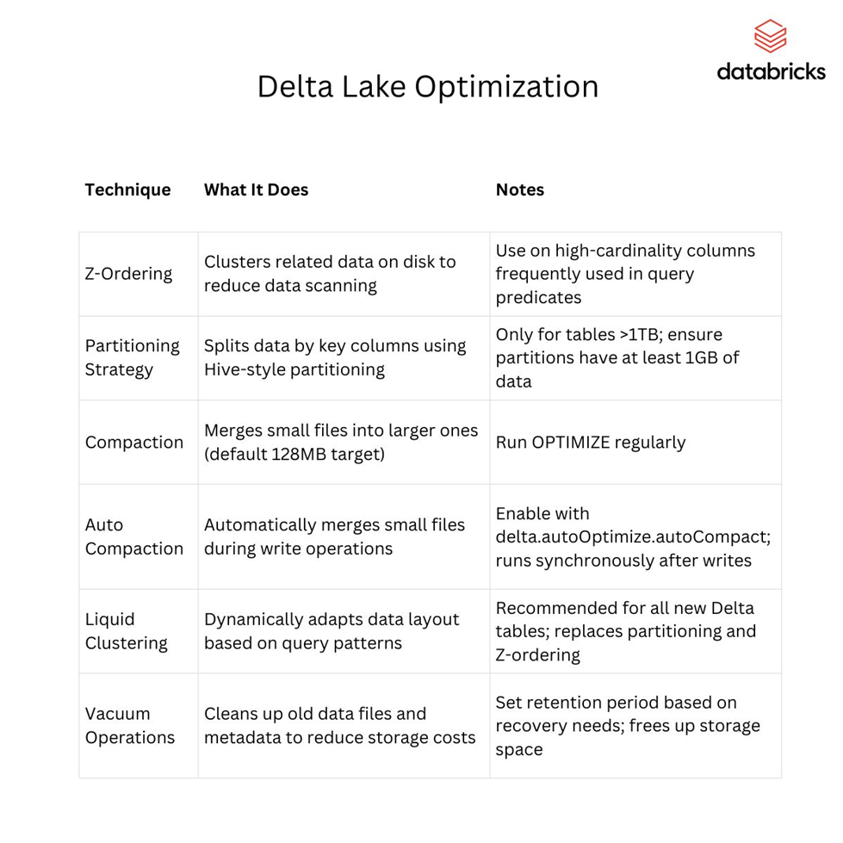

Dr Sachin Saxena
Follow on

Slide 10

Dr Sachin Saxena
Follow on
Step 1: Create ADLS Gen 2 instance
Step 2: Databricks instances and Compute resource
Step 3: Create a Microsoft Entra ID service principal
Step 4: Create new New client secret and Copy Secret Key
Step 5: Add Role Assignment from Access Control (IAM)
Step 6: Put all these credentials at respective places

Slide 11
THANK YOU
Thank you for your time and attention. We hope this presentation has provided valuable insights into the importance of employee training and development programs
Dr Sachin Saxena
Follow on

